Slide 1
Overview of
Wind Turbine Health Impact Study:
Report of Independent Expert Panel
James Manwell
Department of Mechanical and Industrial Engineering
UMass Amherst
Sheryl Grace
Department of Mechanical Engineering
Boston University
Wendy Heiger-Bernays
Department of Environmental Health
Boston University
Overview: Wind Turbine Health Impact Study
MA, 2012

Slide 2
Scope of review
Peer reviewed articles
Epidemiological studies
Biological research associated with vestibular system
Mechanical design and operation of wind turbines
Acoustic and vibration (related)
Animal studies of IFLN
Technical reports
NASA
National Academy of Science
Gray literature
Non peer reviewed epidemiological studies
Books
Other state, country, national reviews related to wind turbines
Public comment
Docket
Web pages, blogs, youtube
100 items cited
More than 100 more articles read
Overview: Wind Turbine Health Impact Study
MA, 2012

Slide 3
Today’s overview
Ice Throw – Jim Manwell
Shadow Flicker – Jim Manwell
Noise and vibration – Sheryl Grace
Health Impact – Wendy Heiger-Bernays
Overview: Wind Turbine Health Impact Study
MA, 2012

Slide 4
Ice Throw
Overview: Wind Turbine Health Impact Study
MA, 2012

Slide 5
Ice Throw
Ice can fall or be thrown from a wind turbine during or after an event when ice forms or accumulates on the blades.
There is sufficient evidence that falling ice is physically harmful and measures should be taken to ensure that the public is not likely to encounter such ice.
Can calculate safe distance using first principles.
Overview: Wind Turbine Health Impact Study
MA, 2012

Slide 6
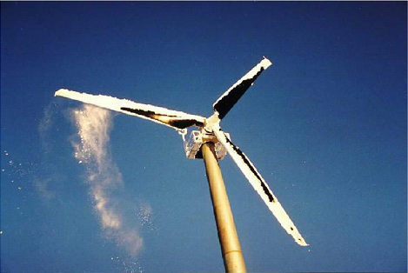
Ice Throw
Typical ice on wind turbine rotor
http://iopara.ca/softwares.html
Ice Falling from Tower
Video of ice falling from TV tower, 1600’ tall →
Overview: Wind Turbine Health Impact Study
MA, 2012
Notes:
http://www.youtube.com/watch?v=pfBp2QYOIbc

Slide 7
Ice Throw
Falling ice can be carried by wind→
Distance can be predicted from wind speed, typical size and shape of pieces of ice
Ice can be released from blade during rotation→
Distance can predicted from Newton’s 2nd Law, also considering
typical size and shape of ice and effect of atmospheric drag
Maximum expected ice throw distances→
1.5 x (Rotor diameter + Tower Height)
Example: 80 m rotor and 80 m tower→ 240 m max likely ice throw
Distance can be minimized by suitable control measures
Overview: Wind Turbine Health Impact Study
MA, 2012

Slide 8
Shadow Flicker
Overview: Wind Turbine Health Impact Study
MA, 2012

Slide 9
Shadow flicker
Shadow flicker results from the passage of the blades of a rotating wind turbine between the sun and the observer.
1. Depends on the location of the observer relative to the
turbine and the time of day and year.
2. Frequency is proportional blade passage frequency and is generally between 0.5 and 1.1 Hz for typical larger turbines.
3. Shadow flicker is only present at distances of less than 1400 m from the turbine.
Video illustrating shadow flicker→
Shadow Flicker
Overview: Wind Turbine Health Impact Study
MA, 2012
Notes:
http://www.youtube.com/watch?v=aMf-Dgvl3b8

Slide 10
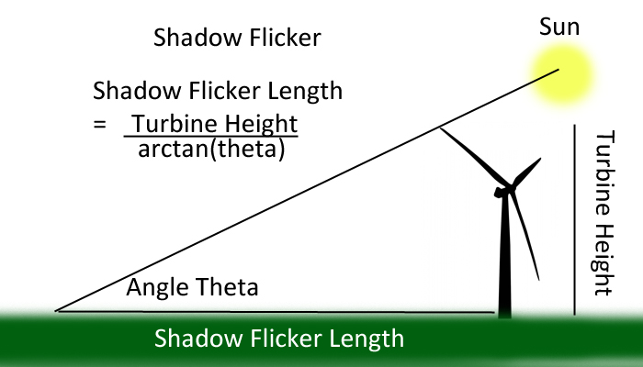
Shadow flicker
Illustration of shadow formation due to wind turbine
http://windandsolarenergycenter.com/wind-turbines-and-%E2%80%98shadow-flicker%E2%80%99/
Overview: Wind Turbine Health Impact Study
MA, 2012

Slide 11
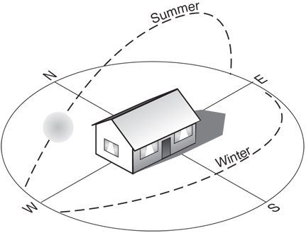
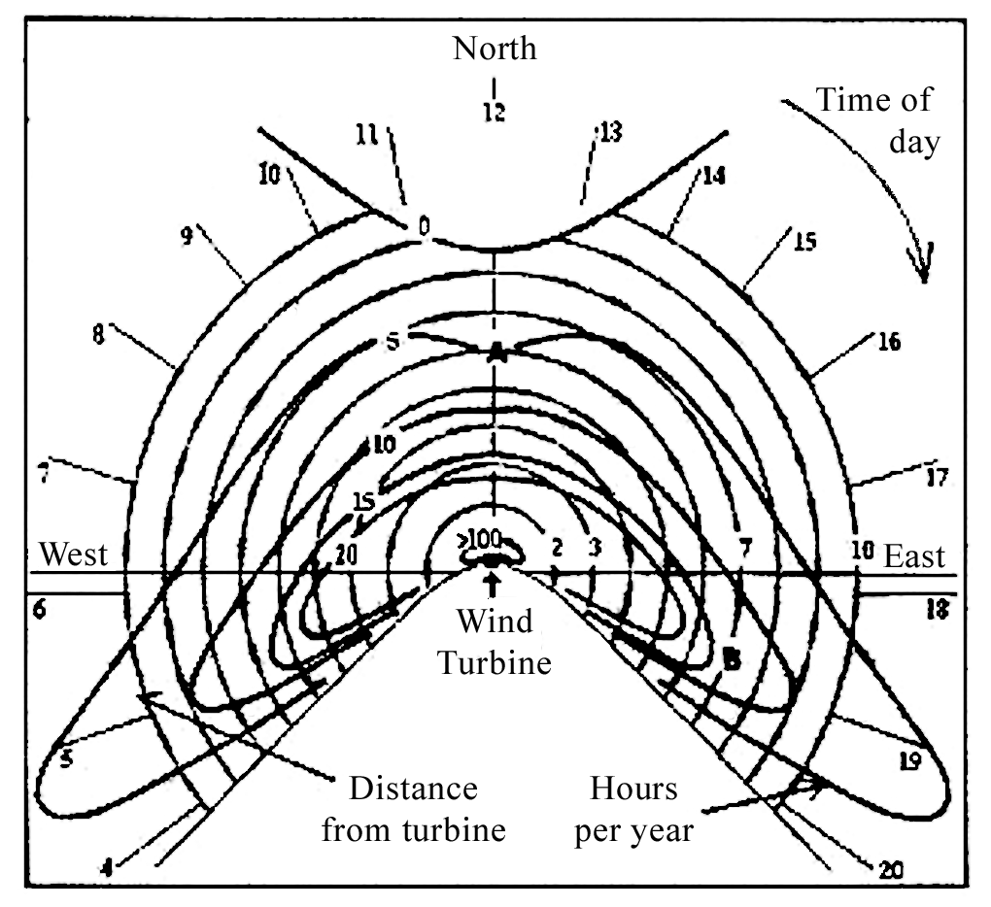
Shadow flicker
Shadows are shorter in summer, longer in winter
Shadows appear to the west of a turbine before noon, to the east after noon.
Typical path of sun
http://oikos.com/library/solar_site_design/index.html
Typical shadow flicker diagram
European Wind Energy Assoc.
Overview: Wind Turbine Health Impact Study
MA, 2012

Slide 12
Shadow flicker
Scientific evidence suggests that shadow flicker does not pose a risk for eliciting seizures as a result of photic stimulation.
There is limited scientific evidence of an association between annoyance from prolonged shadow flicker (exceeding 30 minutes per day) and potential transitory cognitive and physical health effects.
Best practice:
1. Limit maximum flicker time to less than 30 min/day
2. Limit total flicker time to less than 30 hr/yr (assuming clear sky)
Minimize flicker effect by:
1. Choice of location (distance and direction)
2. Limiting rotor speed at certain times
Overview: Wind Turbine Health Impact Study
MA, 2012

Slide 13
Noise and Vibration
Overview: Wind Turbine Health Impact Study
MA, 2012

Slide 14
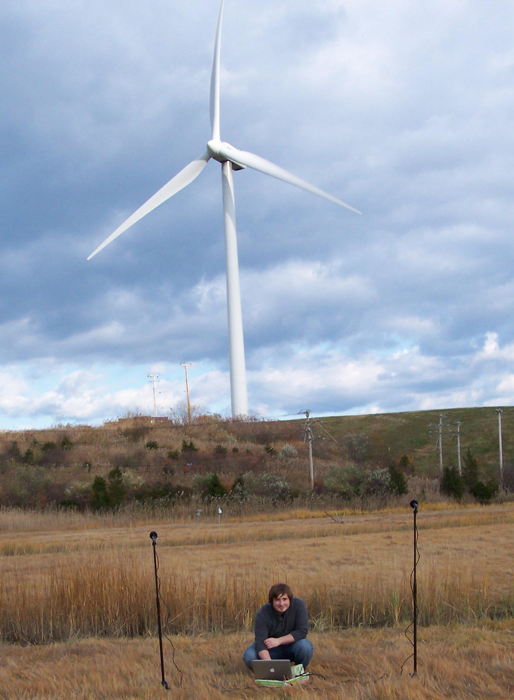
Noise and Vibration -
Noise from wind turbines depends on turbine design
upwind/downwind
stall/pitch regulated
rotational speed
Mod-0
Downwind
200 kW
Vestas V80
1.8 MW
Typical wind farm sound →
Overview: Wind Turbine Health Impact Study
MA, 2012

Slide 15
Noise and Vibration -
Pressure is measured in Pascals (Newton/m²)
To get to dB : sound pressure level:
SPL = 10 log₁₀ [p²/p²_{ref}] = 20 log₁₀(p/p_{ref})
p_{ref} = 20 X 10⁻⁶ Pa = 20μPa
Some characteristics of human response to sound include
Changes in sound level < 1 dB cannot be perceived
Doubling the magnitude of the acoustic pressure leads to a 6 dB increase in SPL
A 5 dB SPL change will result in a noticeable community response
A 10 dB SPL change is subjectively heard as an approximate doubling in loudness.
Overview: Wind Turbine Health Impact Study
MA, 2012

Slide 16
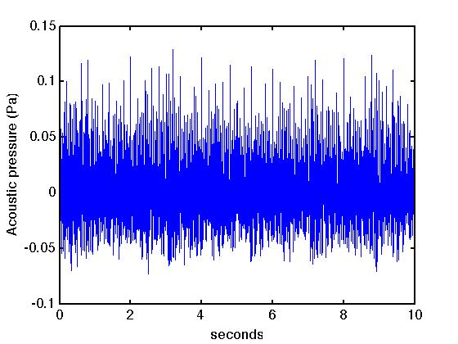
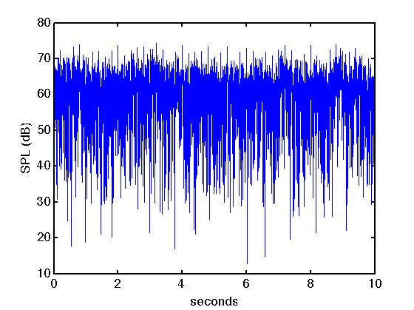
Noise and Vibration -
Start with pressure is measured in Pascals (N/m²)
Change to SPL
Data from German wind farm
Overview: Wind Turbine Health Impact Study
MA, 2012

Slide 17
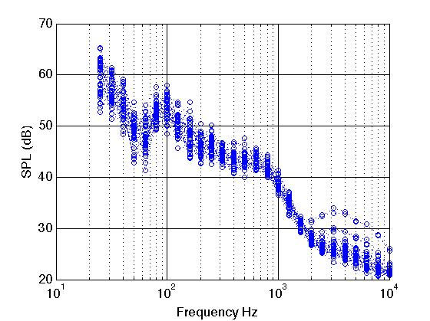
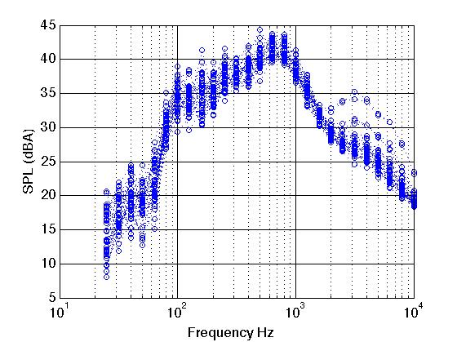
Noise and Vibration -
Move to frequency domain, put in 1/3 octave bands. Used fast averaging method.
Apply A-weighting
Average over all frequencies – get overall sound pressure level reported
Overview: Wind Turbine Health Impact Study
MA, 2012

Slide 18
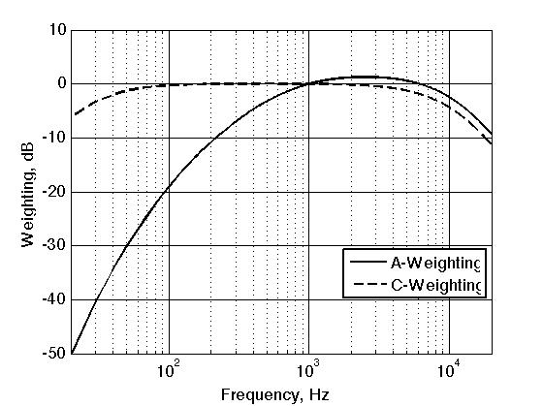
Noise and Vibration -
Weighting curves – A-weighting reflects human perception curve
Overview: Wind Turbine Health Impact Study
MA, 2012

Slide 19
Noise and Vibration -
Typical sound pressure level vs. distance from single wind turbine
Overview: Wind Turbine Health Impact Study
MA, 2012

Slide 20
Noise and Vibration -
Typical sound pressure level vs. distance from multiple wind turbines
Overview: Wind Turbine Health Impact Study
MA, 2012

Slide 21
Noise and Vibration -
Propagation of noise from wind turbines depends on many things
speed of sound gradients (temperature profile)
reflection from hillsides
atmospheric absorption
Audible : “wooshing”, “swish-swish”
due to amplitude modulation of broadband noise generated
because of aerodynamic effects on the blades
pulsates at blade passage frequency (~1 Hz)
affected by wind shear (difference from wind at bottom and top
of blade disk)
perceived as louder at night (stable atmosphere, quiet background)
Overview: Wind Turbine Health Impact Study
MA, 2012

Slide 22
Noise and Vibration -
Infrasound (less than 20 Hz) –
  can be heard if at very high level (> 110 dB)
  can be felt (chest pound) if at very high level (> 110 dB)
  most coupling mechanisms hypothesized in gray literature are not substantiated by levels measured near wind turbines
  recent attention on a part of the inner ear called the Outer Hair Cells that are known to be responsive to infrasound (at lower levels) -- however, evidence does not exist to demonstrate the influence of wind turbine-generated infrasound on vestibular mediated effects in the brain.
Overview: Wind Turbine Health Impact Study
MA, 2012

Slide 23
Noise and Vibration -
Vibration
Seismic (ground-carried) measurements recorded near wind turbines and wind turbine farms are unlikely to couple into structures.
high amplitude impulses that focus due to topography or refraction had been shown to couple into homes near an older downwind turbines (10 out of 1000) (downwind turbine)
haunted space effect – room vibrations due to HVAC or other fan coupled to building
If infrasound [or audible pulses] couples into structures, then people inside the structure could feel a vibration. Such structural vibrations have been shown in other applications to lead to feelings of uneasiness and general annoyance.
[Trusted, reproducible] measurements have not proven such coupling from modern upwind turbines.
Overview: Wind Turbine Health Impact Study
MA, 2012

Slide 24
Health Impacts
Overview: Wind Turbine Health Impact Study
MA, 2012

Slide 25
Health impact of noise and vibration-
We draw conclusions from the science. Associations between exposure and health are based on the weight of the evidence.
Evidence (data that support or refute)
Data/Studies (information/results)
Few epidemiological studies of human health effects from exposures to turbine noise & vibration have been conducted.
Self-reported effects
Lack of robust sound pressure measurements
Hazard-free status cannot be assumed from the weak studies that showed no strong associations between these exposures and illness.
Overview: Wind Turbine Health Impact Study
MA, 2012
Notes:
Of the limited data, most epidemiologic studies on human response to wind turbines relates to self-reported “annoyance,” and this response appears to be a function of some combination of the sound itself, the sight of the turbine, and attitude towards the wind turbine project.
There is limited epidemiologic evidence suggesting an association between exposure to wind turbines and annoyance.
There is insufficient epidemiologic evidence to determine whether there is an association between noise from wind turbines and annoyance independent from the effects of seeing a wind turbine and vice versa.

Slide 26
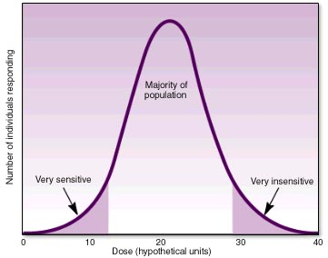
Health impact of noise and vibration
Public Health Impact = Wide ranging; physical and/or psychological
  Population response to stimuli
Overview: Wind Turbine Health Impact Study
MA, 2012

Slide 27
Health impact of noise and vibration-
Syndrome – essential characteristics that appear together
There is no evidence (for the explanation provided) for a set of health effects, from exposure to wind turbines that could be characterized as a "Wind Turbine Syndrome.”
All reported health impacts in Massachusetts are near a single installation
Overview: Wind Turbine Health Impact Study
MA, 2012

Slide 28
Health impact of noise and vibration-
Most epidemiologic studies on human response to wind turbines relates to self-reported “annoyance,”
limited epidemiologic evidence suggesting an association between exposure to wind turbines and annoyance.
Cannot determine whether there is an association between noise from wind turbines and annoyance independent from the effects of seeing a wind turbine and vice versa.
Self-reported “annoyance”
Overview: Wind Turbine Health Impact Study
MA, 2012
Notes:
Of the limited data, most epidemiologic studies on human response to wind turbines relates to self-reported “annoyance,” and this response appears to be a function of some combination of the sound itself, the sight of the turbine, and attitude towards the wind turbine project.
There is limited epidemiologic evidence suggesting an association between exposure to wind turbines and annoyance.
There is insufficient epidemiologic evidence to determine whether there is an association between noise from wind turbines and annoyance independent from the effects of seeing a wind turbine and vice versa.

Slide 29
Health impact of noise and vibration-
Limited evidence from epidemiological studies suggesting an association between noise from wind turbines and sleep disruption…. it is possible that noise from some wind turbines can cause sleep disruption.
There is not enough evidence to provide particular sound-pressure thresholds at which wind turbines cause sleep disruption. Further study would provide these levels.
Whether annoyance from wind turbines leads to sleep issues or stress has not been sufficiently quantified. While not based on evidence of wind turbines, there is evidence that sleep disruption can adversely affect mood, cognitive functioning, and overall sense of health and well-being.
Possible sleep disruption.
Sleep disruption DOES adversely affect health
Overview: Wind Turbine Health Impact Study
MA, 2012

Slide 30
Health impact of noise and vibration-
Insufficient evidence that the noise from wind turbines is directly (i.e., independent from an effect on annoyance or sleep) causing health problems or disease.
The weight of the evidence suggests no association between noise from wind turbines and measures of psychological distress or mental health problems
Insufficient data to suggest an association between noise from wind turbines and pain and stiffness, diabetes, high blood pressure, tinnitus, hearing impairment, cardiovascular disease, and headache/migraine.
Not enough data to suggest an association between wind turbine noise and a multitude of health effects
Overview: Wind Turbine Health Impact Study
MA, 2012
Notes:
The strongest epidemiological study suggests that there is not an association between noise from wind turbines and measures of psychological distress or mental health problems. There were two smaller, weaker, studies: one did note an association, one did not.
Therefore, we conclude the weight of the evidence suggests no association between noise from wind turbines and measures of psychological distress or mental health problems.
None of the limited epidemiological evidence reviewed suggests an association between noise from wind turbines and pain and stiffness, diabetes, high blood pressure, tinnitus, hearing impairment, cardiovascular disease, and headache/migraine.

Slide 31
Consensus report
Panel made of individuals with expertise in different, yet relevant areas.
There was overlap in the literature that was reviewed by the panel members.
Panel members formed individual opinions, discussions were based on need to share expertise in order to develop completely informed set of findings and best practices.
All panel members reviewed the data and came to consensus.
Overview: Wind Turbine Health Impact Study
MA, 2012

Slide 32
Best Practices
Overview: Wind Turbine Health Impact Study
MA, 2012

Slide 33
Best Practices for Moving Forward
The best practices exist because it has been shown that self-reported annoyance, sleep deprivation, and health effects are greatly reduced when certain considerations are given
The best practices could inform policy
The best practices could be useful to municipalities
Use calculation method available for ice throw distances
Adhere to < 30 min/day, 30 hrs/year for shadow flicker
Overview: Wind Turbine Health Impact Study
MA, 2012

Slide 34
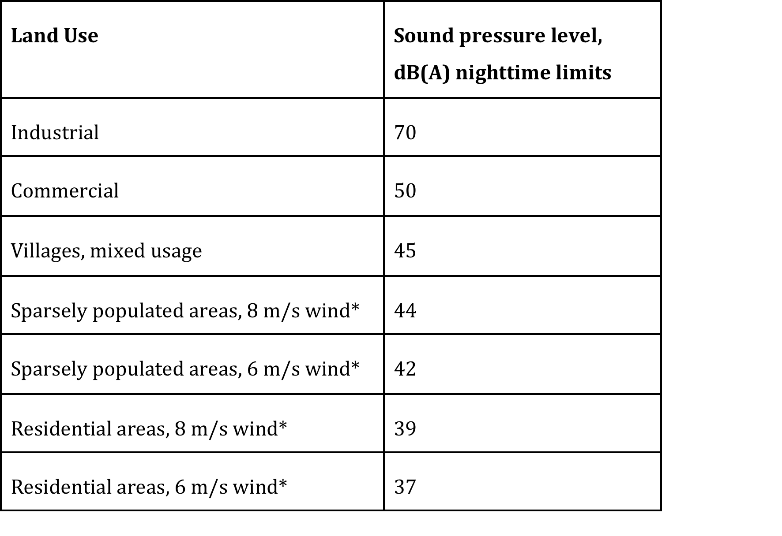
Best Practices for Moving Forward
Consider noise limits used in other countries
Must define averaging window
Overview: Wind Turbine Health Impact Study
MA, 2012

Slide 35
Best Practices for Moving Forward
Know type of turbine and noise specs for turbine
Ongoing program of monitoring and evaluation of sound produced by wind turbines is suggested
Closer investigation of homes where A and C weighting noise measurements outside differ by 15 dB or more
Direct involvement of neighbors in wind turbine development and economic plan is suggested
Continued public engagement
Overview: Wind Turbine Health Impact Study
MA, 2012

Slide 36
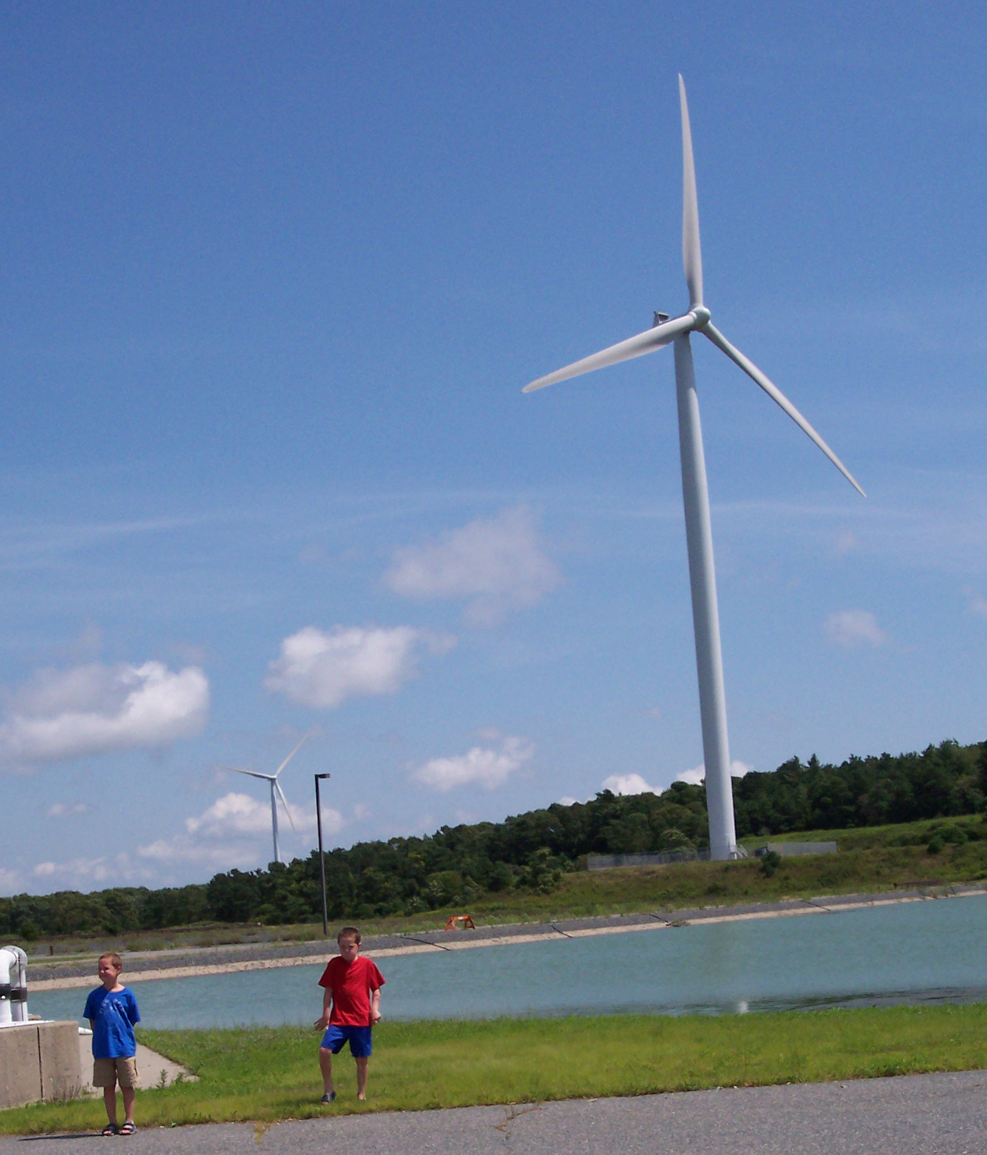
Questions
Vestas V82
1.65 MW
Overview: Wind Turbine Health Impact Study
MA, 2012

