Slide 1
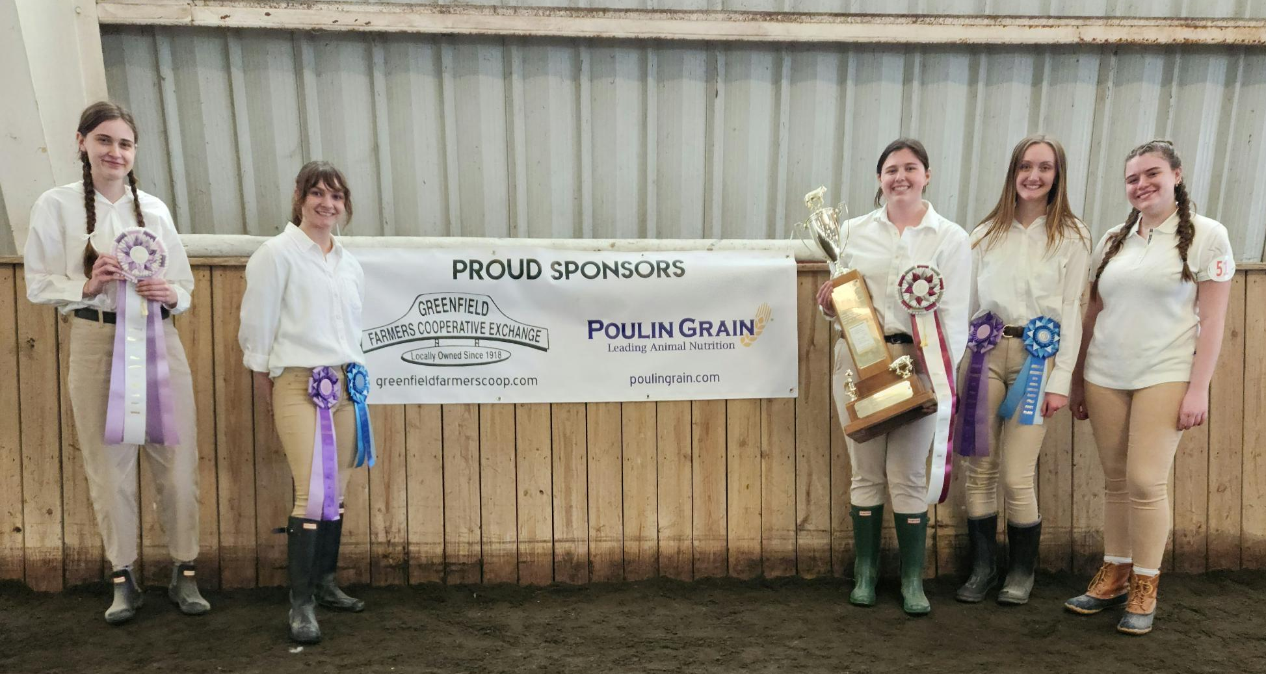
2023 Premier Showperson Finalists:
Sophia Gemignani, Chloe Pelrine, Maggie Dowell, Ashley Lenihan, and Lily Bennett

Slide 2
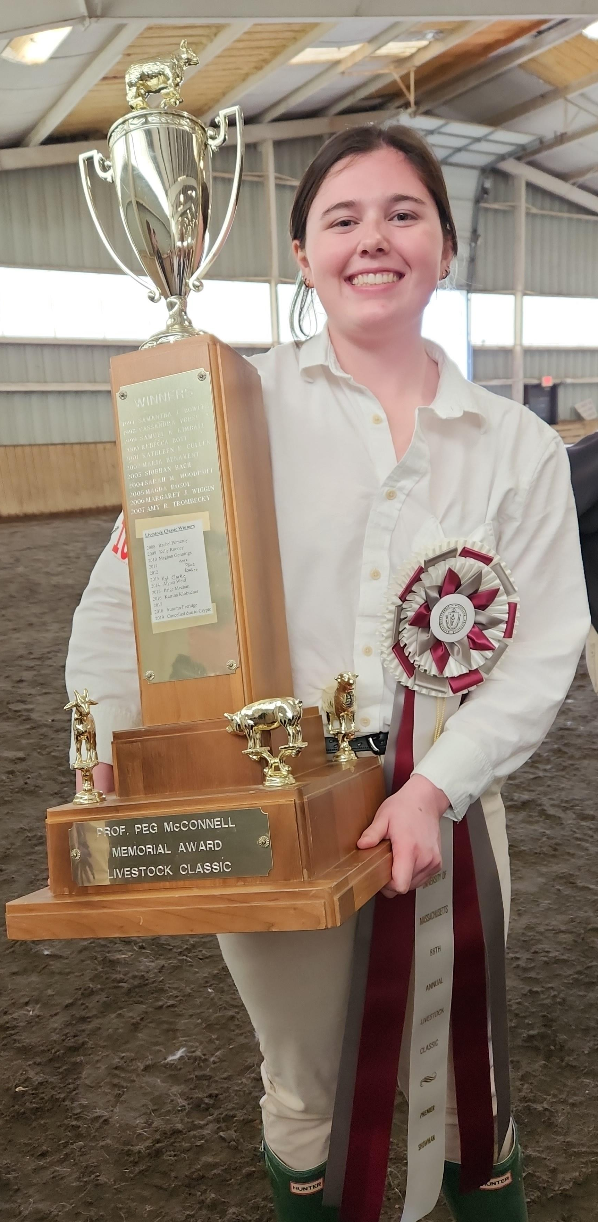
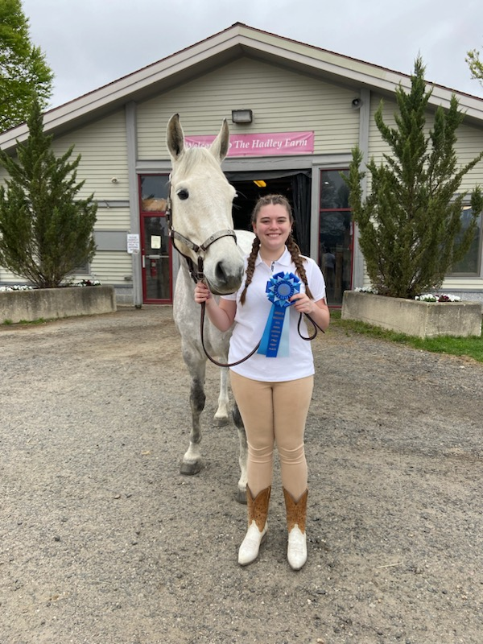
Pictured Left: 2023 Premier Showperson, Maggie Dowell
Pictured Right: 2023 Equine Division Winner Lily Bennett

Slide 3
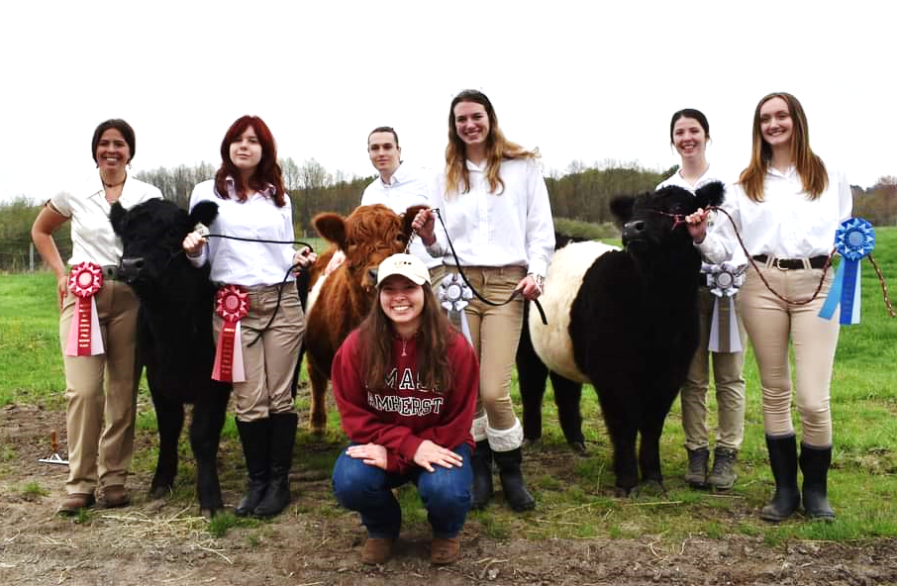
2023 Belted Galloway Division: Madaket Blaze, Jenna Learned, Anton Vilensky,
Abby Cousineau, Lily Waters, Ashley Lenihan. kneeling: Sarah Young

Slide 4
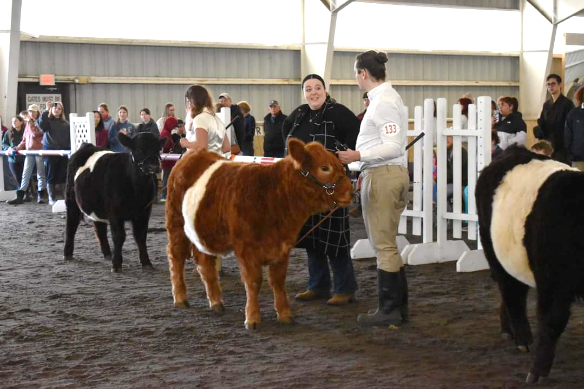
An exciting round in the Belted Galloway division judged by Kenzie McLarnon

Slide 5
Judge Weston Brown, DVM UMass ‘12, sorts through the Boer Goat Division

